Slide 1

Lecture – 6 Constructor and Constructor Overloading
Afsara Tasneem Misha
Lecturer
Department of CSE
Daffodil International University

Slide 2
Contents
Constructor in Java
Constructor Overloading

Slide 3
Topic – 1: Constructor in Java

Slide 4
Introduction to Constructor
A constructor in Java is a special method
used to initialize objects.
constructor name must match the class name
it cannot have a return type (not even void).
Also note that the constructor is called when the object is created.
All classes have constructors by default: if you do not create a class constructor yourself, Java creates one for you and initiate the variables with default value such as 0 or NULL.

Slide 5
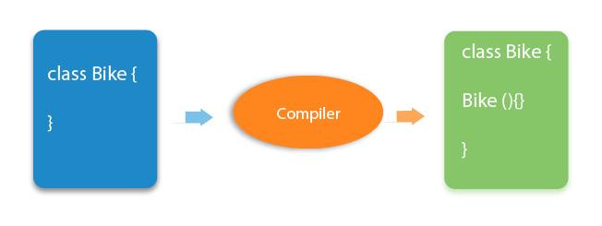
Compiler creates constructor for you

Slide 6
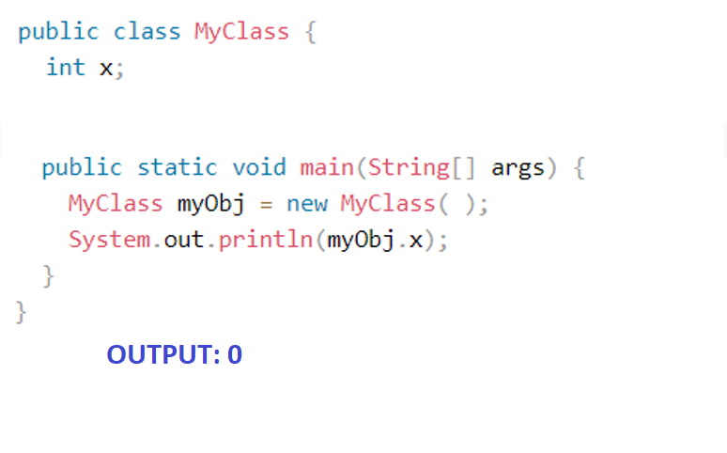
Example – 1

Slide 7
Example – 2
public class MyClass {
int x;
public MyClass() {
x = 5;
}
public static void main(String[] args) {
MyClass myObj = new MyClass();
System.out.println(myObj.x);
}
}

Slide 8
Example - 3
Example – 3
public class Demo
{
public Demo()
{
System.out.println("This is a no argument constructor");
}
public static void main(String args[]) {
Demo demo1 = new Demo();
}
}

Slide 9
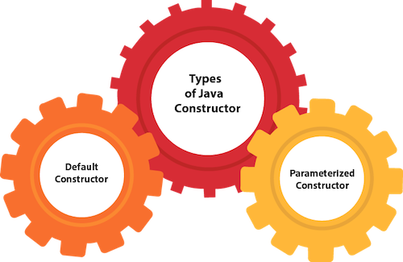
Types of Java constructors
There are two types of constructors in Java:
Default constructor (no-arg constructor)
Parameterized constructor

Slide 10
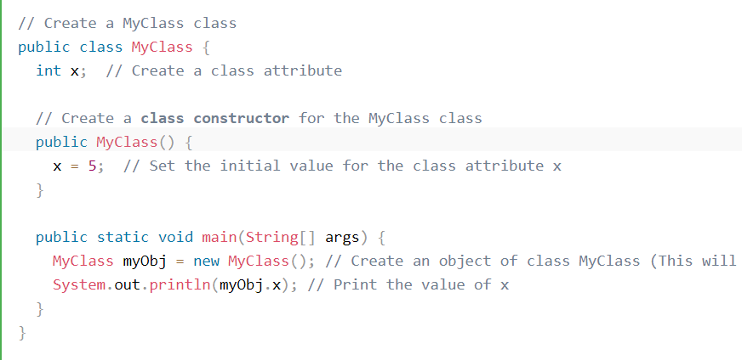
1. Default constructor (no-arg constructor)

Slide 11
Example : Default constructor (no-arg constructor)
public class Box1 {
int height;
int width;
public Box1()
{
System.out.println("Box Created.");
this.height = 10;
this.width = 20;
}
public static void main(String[] args) {
Box1 box1 = new Box1();
System.out.println("The height of box1 = "+box1.height);
System.out.println("The width of box1 = "+box1.width);
Box1 box2 = new Box1();
System.out.println("\nThe height of box2 = "+box2.height);
System.out.println("The width of box2 = "+box2.width);
}
}

Slide 12
Example : Default constructor (no-arg constructor)
public class Box{
int height;
int width;
public Box()
{
System.out.println("Box Created.");
this.height = 10;
this.width = 20;
}
public static void main(String[] args) {
Box1 b1 = new Box();
System.out.println("The height of box1 = "+b1.height);
System.out.println("The width of box1 = "+b1.width);
Box1 b2 = new Box();
System.out.println("\nThe height of box2 = "+b2.height);
System.out.println("The width of box2 = "+b2.width);
}
}
Box
height : int width : int
+Box() +main(String[] ) : void

Slide 13
2. Parameterized constructor
public class MyClass {
int x;
public MyClass ( int y) {
x = y;
}
public static void main(String[] args) {
MyClass myObj = new MyClass(50);
System.out.println(myObj.x);
}
}

Slide 14
Example - 1 : Parameterized constructor
public class Box {
int height;
int width;
public Box(int a, int b) {
System.out.println("\nBox Created.");
this.height = a;
this.width = b;
}
public static void main(String[] args) {
Box b1 = new Box(10, 20);
System.out.println("The height of box1 = " + box1.height);
System.out.println("The width of box1 = " + box1.width);
Box b2 = new Box(15, 25);
System.out.println("The height of box2 = " + box2.height);
System.out.println("The width of box2 = " + box2.width);
}
}
Box
height : int width : int
+Box(int, int) +main(String[] ) : void

Slide 15
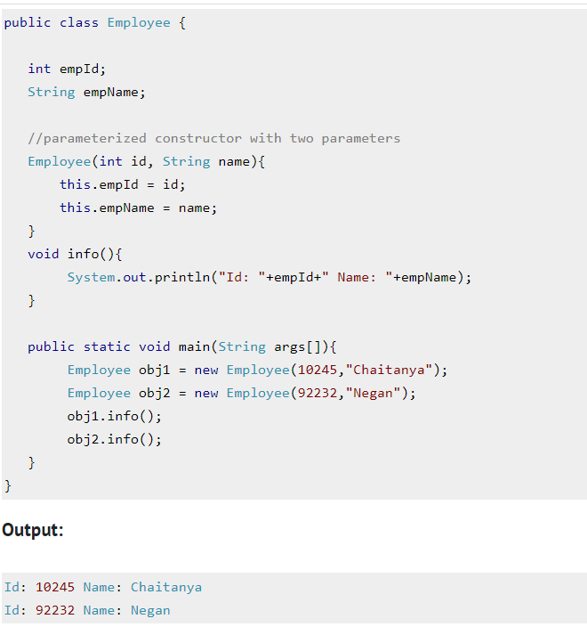
Example - 2 : Parameterized constructor

Slide 16
Example: 1
Example - 2 : Parameterized constructor

Slide 17
Topic – 2: Constructor Overloading in Java

Slide 18
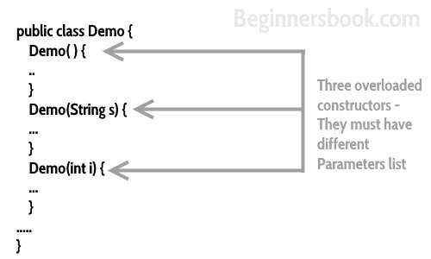
Constructor Overloading
Constructor overloading is a concept of having more than one constructors with different parameters list, in such a way so that each constructor performs a different task.

Slide 19
public class Box { private int height , width; public Box() { height = 10; width = 15; } public Box (int height, int width) { this.height = height; this.width = width; } public static void main(String[] args) { Box b1 = new Box(); Box b2 = new Box(20,30); Box b3 = new Box(50,60); Box b4 = new Box(); System.out.println("For Box-1: Height = " + b1.heigh+ “Width = “ +b1.width); System.out.println("For Box-2: Height = " + b2.heigh+ “Width = “ +b2.width); System.out.println("For Box-3: Height = " + b3.heigh+ “Width = “ +b3.width); System.out.println("For Box-4: Height = " + b4.heigh+ “Width = “ +b4.width); } }
Example - 1 : constructor Overloading

Slide 20
public class Box { private int height , width; public Box() { height = 10; width = 15; } public Box (int height, int width) { this.height = height; this.width = width; } public static void main(String[] args) { Box b1 = new Box(); Box b2 = new Box(20,30); Box b3 = new Box(50,60); Box b4 = new Box(); System.out.println("For Box-1: Height = " + b1.heigh+ “Width = “ +b1.width); System.out.println("For Box-2: Height = " + b2.heigh+ “Width = “ +b2.width); System.out.println("For Box-3: Height = " + b3.heigh+ “Width = “ +b3.width); System.out.println("For Box-4: Height = " + b4.heigh+ “Width = “ +b4.width); } }
Example - 1 : constructor Overloading
Box
height : int width : int
+Box() +Box(int , int) +main(String[] ) : void

Slide 21
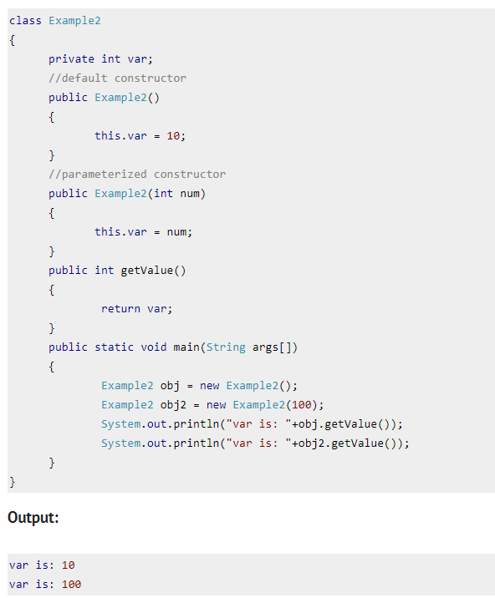
Example - 2 : constructor Overloading

Slide 22
Difference between constructor and method in Java
Java Constructor | Java Method
A constructor is used to initialize the state of an object. | A method is used to expose the behavior of an object.
A constructor must not have a return type. | A method must have a return type.
The constructor is invoked implicitly. | The method is invoked explicitly.
The Java compiler provides a default constructor if you don't have any constructor in a class. | The method is not provided by the compiler in any case.
The constructor name must be same as the class name. | The method name may or may not be same as the class name.

Slide 23
Some helpful Links
https://www.w3schools.com/java/java_constructors.asp
https://beginnersbook.com/2013/03/constructors-in-java/
https://www.javatpoint.com/java-constructor

Slide 24

Thank you!

